Slide 1
Simple Alexa Smart Home Project
Door bell to launch Bosch Eyes carema stream on Amazon Echo Show 10

Slide 2
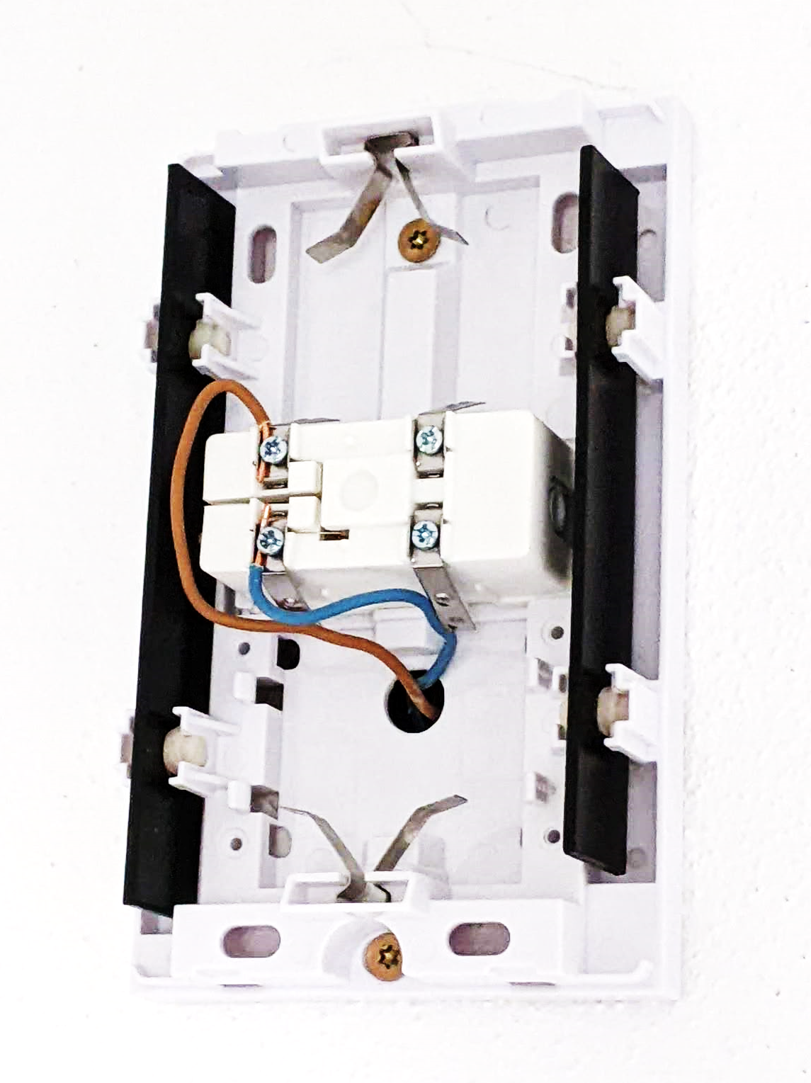
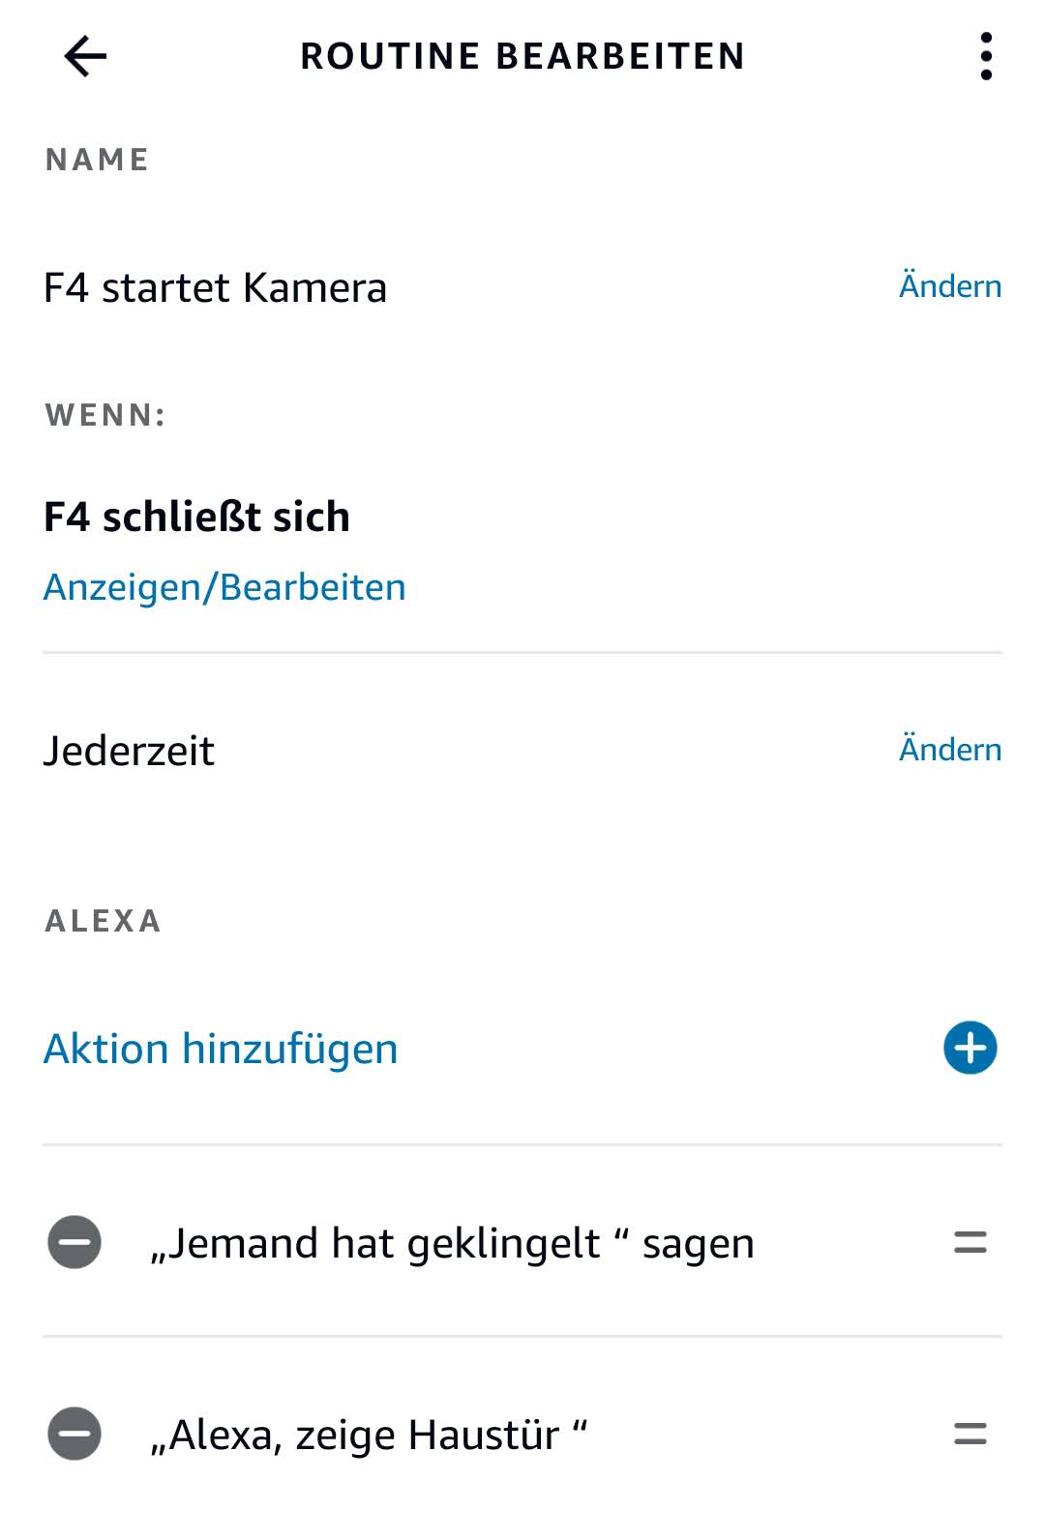
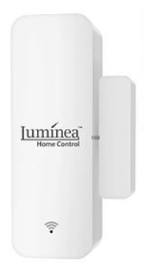
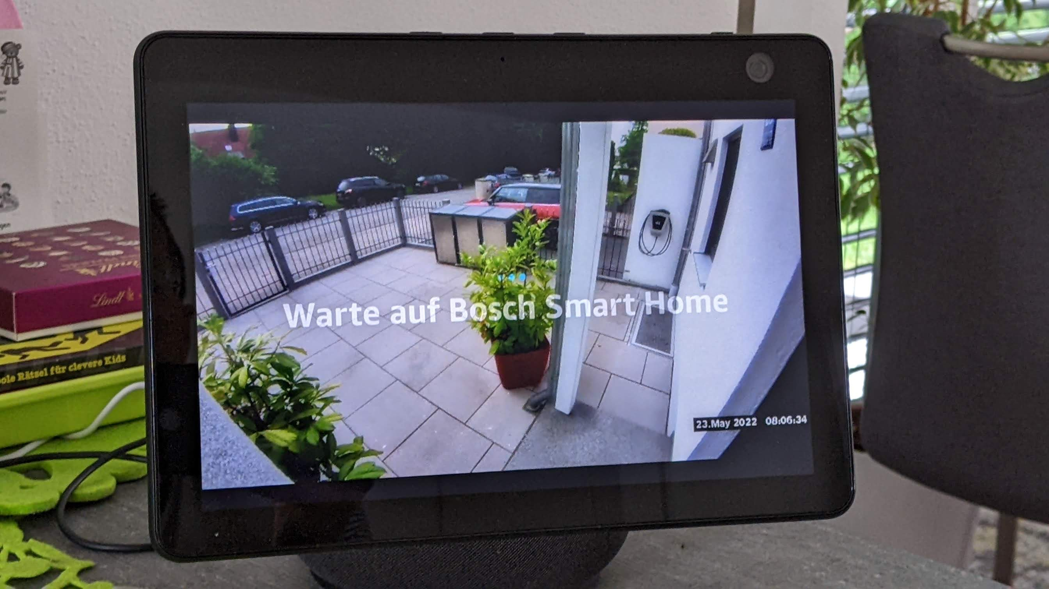
Intended action flow
Guest presses door bell button
12VAC on at the ring bell
Custom pull-down circuit to be developed
Smart home reed window contact
Alexa routine
Launch Bosch Skill
Task: Convert 12VAC into pull-down switch contact parallel to reed switch in window contact

Slide 3
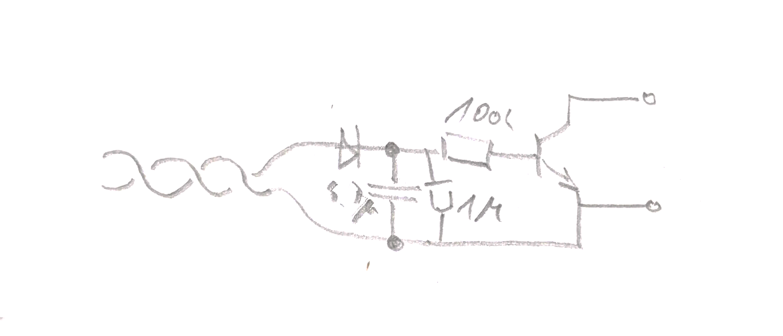
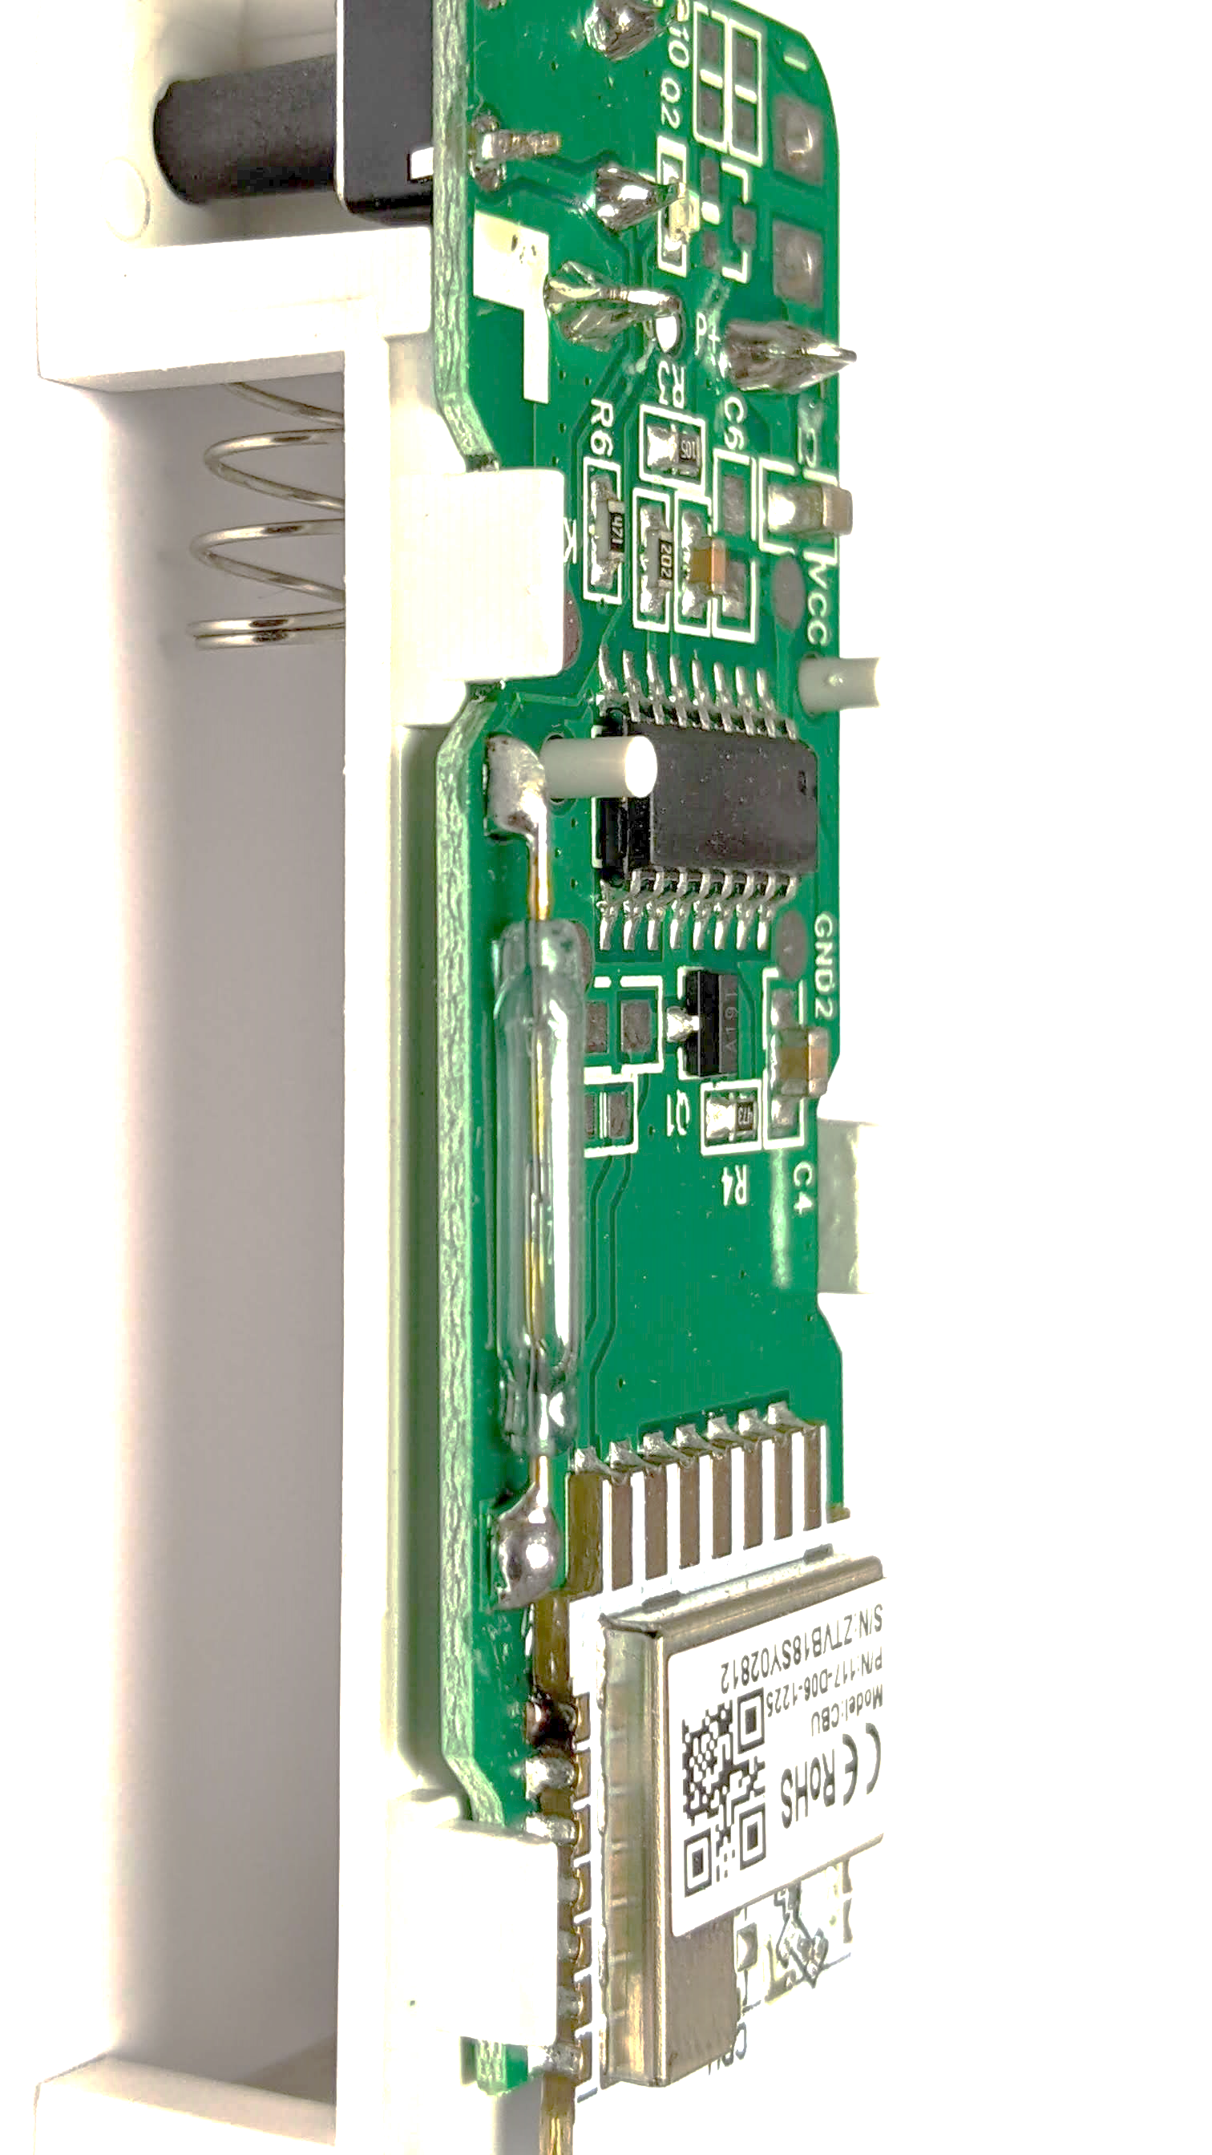
pull-down circuit, V1

Slide 4
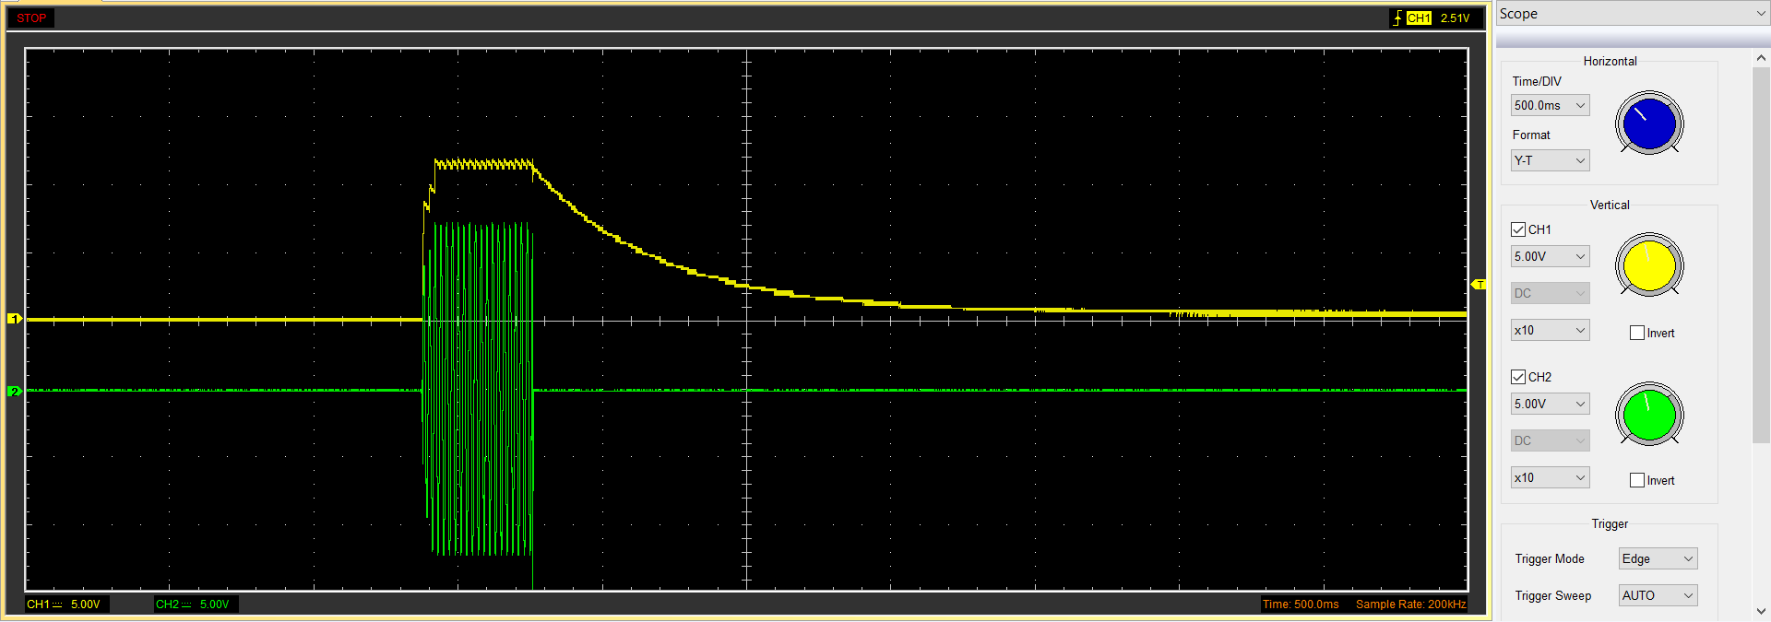
pull-down circuit, V1
tau = 450ms = RC
R = 450450ms / 4.7µF = 95MΩ okay!

Slide 5
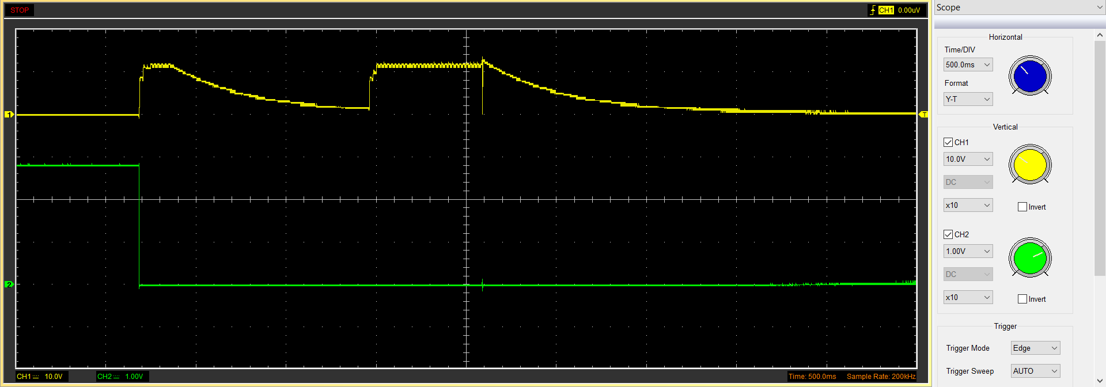
Short press
long press
switch on
(pull-down)
Problem with pull-down circuit V1: Transistor doesn‘t switch off reliably

